Slide 1
The Amendments
By: Meredith Maxwell

Slide 2
The 1st Amendment
The First Amendment is the freedom of religion.
It lets you worship as you please
Gather in a peaceful manner and discuss unfair laws
Write about what you want
Express your opinions

Slide 3
The 2nd Amendment
Right to Bare Arms
You may own a gun

Slide 4
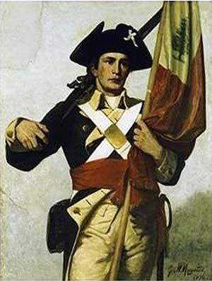
The 3rd Amendment
Quartering Soldiers
You do not have to cook and clean for soldiers
You do not have to let a soldier into your house

Slide 5
The 4th Amendment
Search and Seizure
You may not search someone if you do not have proof that they did the crime

Slide 6
Amendment 5-8
Trial and Judgment
You have the right to have a fair and speedy trial
You have the right for your case decide by a jury
The right to have a lawyer

Slide 7
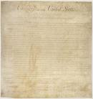
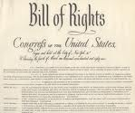
The 9th Amendment
Bill of Right
Any right not listed in the constitution is not retained by the people

Slide 8
The 10th Amendment
State Powers and Rights
Governmental powers not listed in the constitution for the national government are the powers of the states or the people in those states

Slide 9
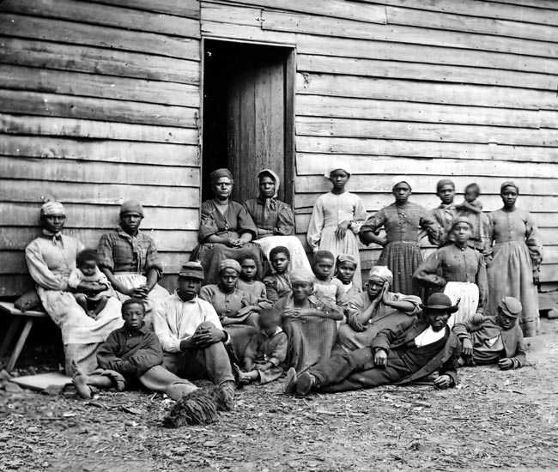
The 13th Amendment
Abolished Slavery
You may not own a slave
Consequences are harsh if you do

Slide 10
The 15th Amendment
The Right to Vote
You may not deny someone's vote because of there race or color

Slide 11
The 19th Amendment
Women’s Rights
In the 20th century women did not have the right to vote
It took nearly 100 years to gain the right to vote
It was in 1920 women got the right to vote

