Slide 1
Welcome!
Today you are going to
expand your vocabulary!
Are you ready?
An Academic Vocabulary Lesson
Notes:
This lesson is designed to help students gain an in-depth understanding of the word compare. It includes many opportunities for them to compare items in pieces of art. Students will also read sample sentences that contain the word compare to arrive at their own definitions of it.
Throughout the lesson, read the text in the speech bubbles to students or let students read it independently. Use the text and the images to make the lesson interactive.

Slide 2
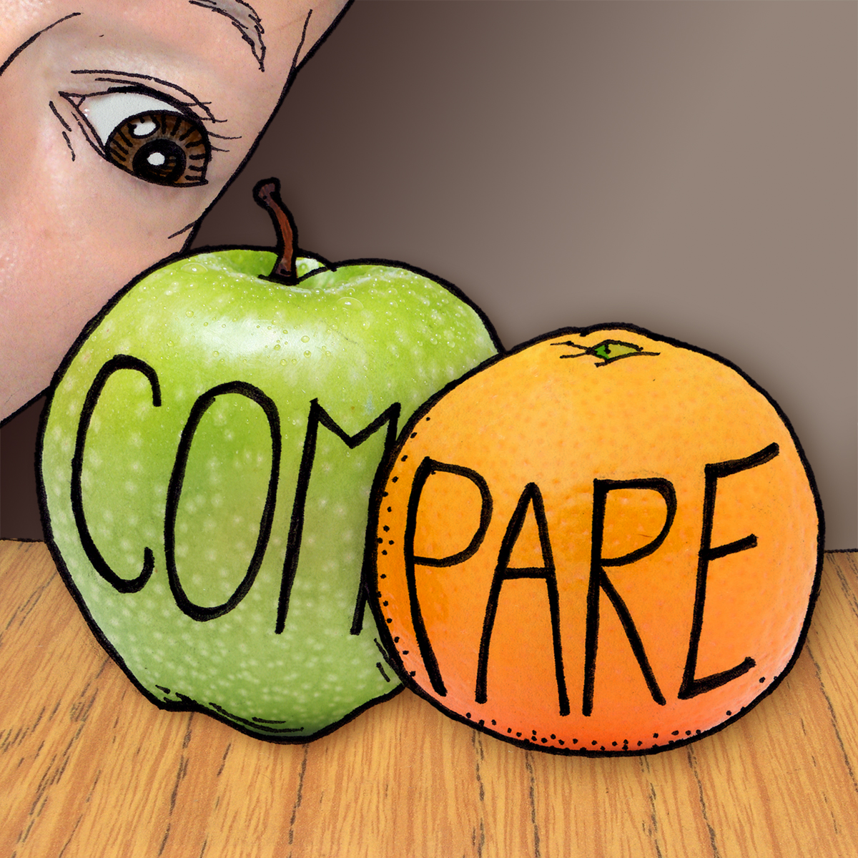
Talk to a
partner about what you notice about these two pieces of fruit.
Notes:
Open the lesson by inviting students to discuss with a partner what they notice about the two pieces of fruit in this image. After students have had time to talk, invite them to share their ideas with the class. Some students may notice that the word compare is written on the pieces of fruit, or they may actually compare characteristics of the two pieces of fruit. They may notice that someone is looking at the fruit. Explain to students that today they will be thinking deeply about the meaning of the word compare.

Slide 3
Sample Sentences
What can you figure out about the word compare by reading these sentences?
If you compare a crocodile to an alligator, you will see their differences.
To compare two cells, scientists put them side by side.
Her creativity was beyond compare.
Notes:
Explain to students that we learn new words best by seeing them in multiple contexts, as presented here. Either read the sentences as a class or ask students to read them in pairs or independently. Ask them to think about the meaning of the word compare as they read.

Slide 4
Work with a partner to write a definition for this word.
compare
?
Notes:
Ask students to think about the word compare and use their thinking about the fruit image and the three sentences to formulate their own definition of compare. When they’re finished, have them share their definitions and then collaborate on class definition of the word.

Slide 5
“Compare” your definition to this one. Do you think you understand what compare means?
compare
to put two or more things next two each other to see how they are the same or different
Notes:
Show students this more formal definition of the word compare. Ask them to identify similarities and differences in this definition and theirs. Before moving onto the next part of this lesson, make sure students have a firm grasp of the meaning of compare

Slide 6
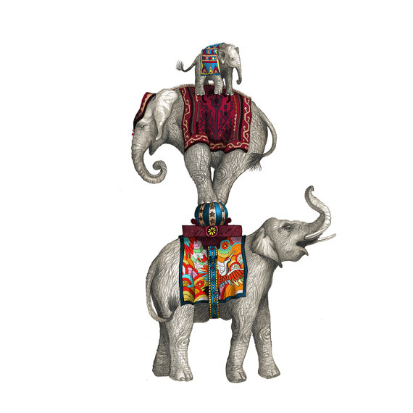
Compare the elephants in this picture?
Elephant Family by Jessica Boehman
Notes:
Each of the following three slides invites comparisons. Present each image to students and encourage them to compare items in them. Make sure they offer examples of the ways the items are similar and different.

Slide 7
What
happens to your comparison when you are looking at many examples of something?
Art Study of Beetles by Christina Glaser
Notes:
Let students compare the beetles in this image. How is comparing an image with multiple items different from comparing an image with just two or three items? Students might notice that, in comparing an image with multiple items, they are more likely to use words such as all, some, most, or a few.

Slide 8
Why is this
picture not good for making comparisons?
Anjou Pear by Clair Hartmann
Notes:
Let students look at this image and consider how it relates to the word compare. They should notice that, because there is only one pear shown, there isn’t really anything to compare in the image. If students mention that you could compare the pear to the cloth it is resting on, use it as a segue to the next image, which invites comparisons of items that are not similar.

Slide 9
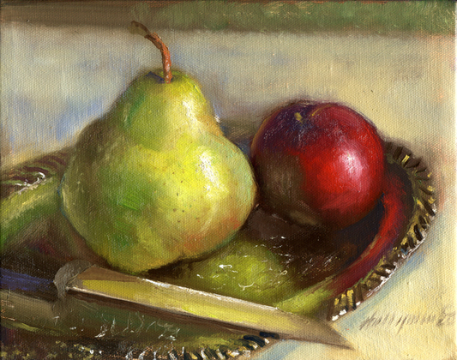
Comparing two
things that are pretty similar is simple, such as comparing this pear and this apple. But what happens if you compare the pear
and the knife?
Pear, Plum & Knife on Silver Plate by Hall Groat II
Notes:
Ask students to think about what makes some comparisons easier or harder. Let them compare the knife and the pear in this image. Depending on your grade-level, you may want to capture students’ responses on a Venn diagram.

Slide 10
Now it’s your
turn. Compare two
things in this picture.
Untitled by Nathaniel Burkins
Notes:
Let students work individually or with partners to compare two things in this picture. They may compare the two dogs, a dog and a human, the two men, or even something living, such as the man standing, and something non-living, such as the wastebasket. Students may simply share their comparisons verbally or capture them in Venn diagrams.

Slide 11
Now you know
what it means to compare.
By the way, compare this
lesson that uses art with
vocabulary lessons that
don’t use it. Which do
you prefer?
Notes:
Let students summarize their new understandings of the word compare.

Slide 12
Thank you for
learning together.
You are beyond
compare!

Slide 13
Second-Grade Common Core Alignments
Third-Grade Common Core Alignments
Fourth-Grade Common Core Alignments
For you,
teacher!
Notes:
CCSS alignments for this lesson

