Slide 1




Notes:
Note to Lead RISE Teacher: Become familiar with The Next Step Forward in Reading Intervention (NSFRI) and The Next Step Forward in Guided Reading (NSFGR) before you present this PowerPoint to your leadership team. Have both books available for participants. Explain the purpose of this session: We need a short-term reading intervention that quickly accelerates our striving readers. The RISE framework, based on Jan Richardson’s The Next Step Forward in Guided Reading, provides 6 to 8 weeks of intensive, integrated, and targeted instruction in reading, writing, and word study.

Slide 2
What Is RISE? Reading Intervention for Students to Excel
An effective model for grades 1 to 5, based on Jan Richardson's theory and practice.
For up to 16 striving readers, in four small groups.
Four stations that focus on new book reading, comprehension, word study, and guided writing; 45 to 60 minutes per day for six to eight weeks.
Required resources: instructors, good leveled texts, and available space.
Notes:
RISE is designed for primary students reading at text levels C-N who need to improve decoding, spelling, fluency, and comprehension. Key points to make as you present each bullet:
RISE instructors must be familiar with The Next Step Forward in Guided Reading.
Students are reading at about the same text level and divided into small groups (no more than 4 per group).
Students spend 12–15 minutes at each station that is lead by an instructor and focuses on one aspect of the reading process.
The 45-minute model uses three stations (Read a New Book, Phonics and Word Study, and Guided Writing).
Instructors can be special-education teachers, Title I teachers, reading interventionists, ELL teachers, literacy coaches, retired teachers, student teachers, teaching assistants, or other adults who routinely work with students in your school.

Slide 3
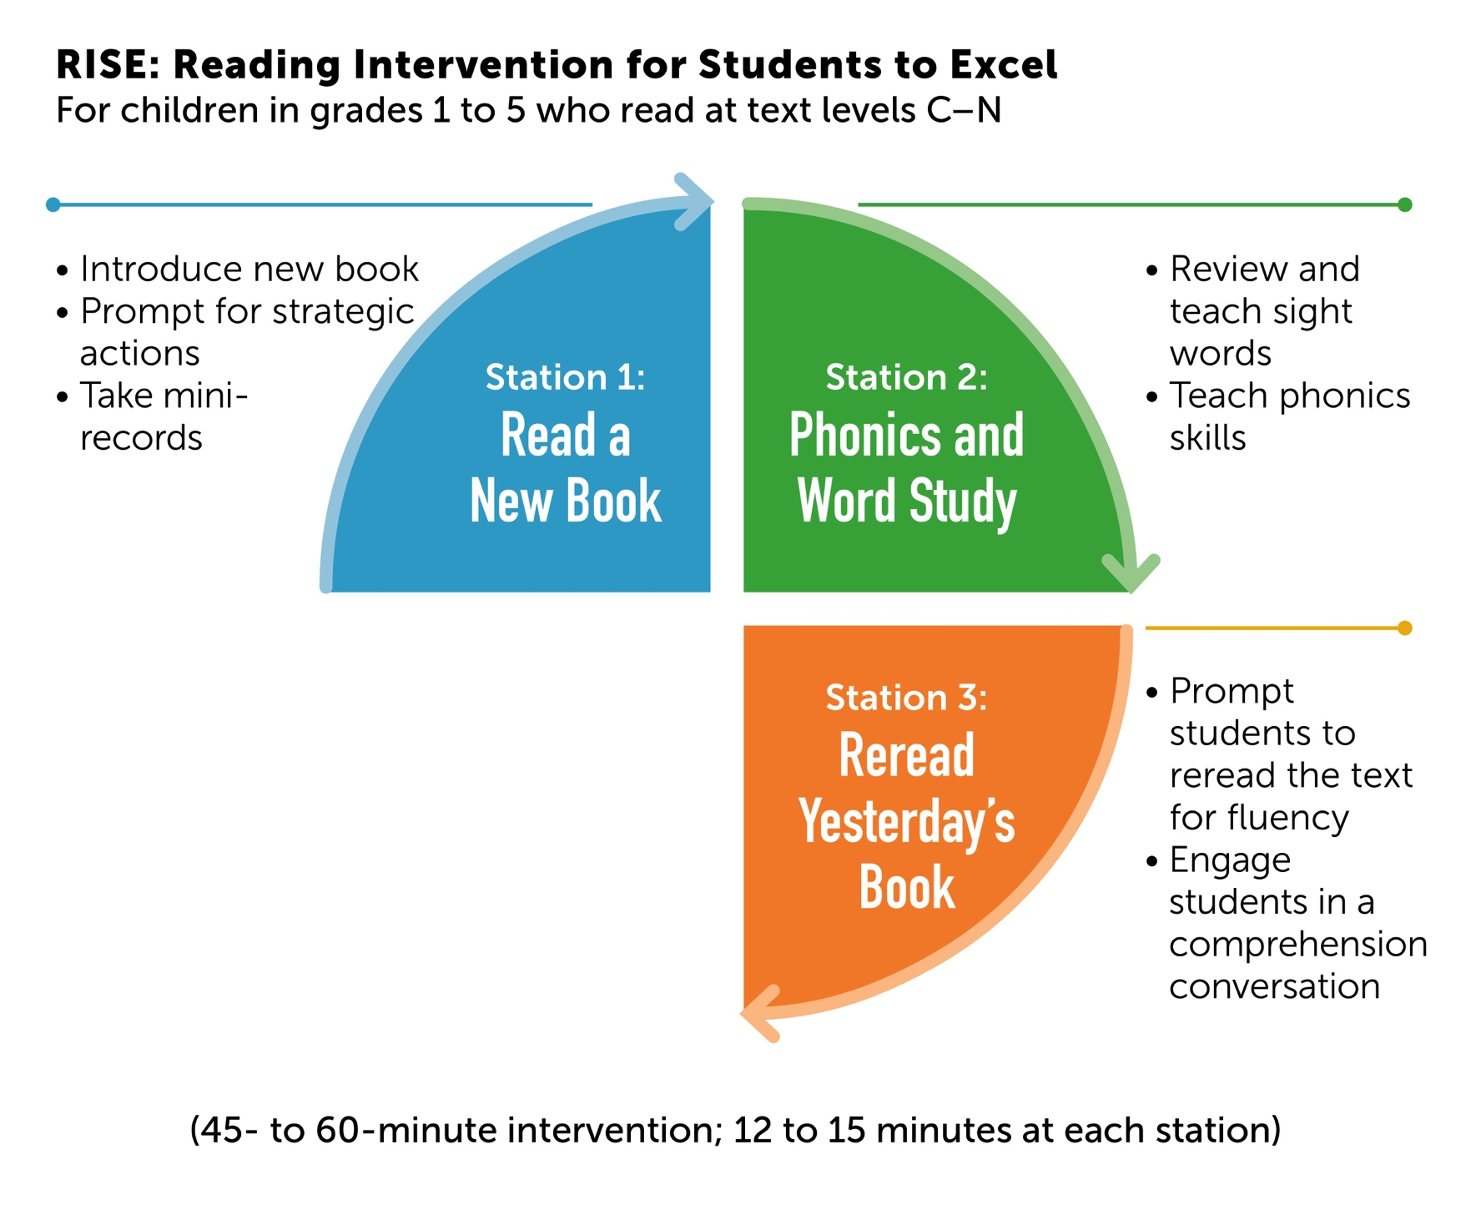
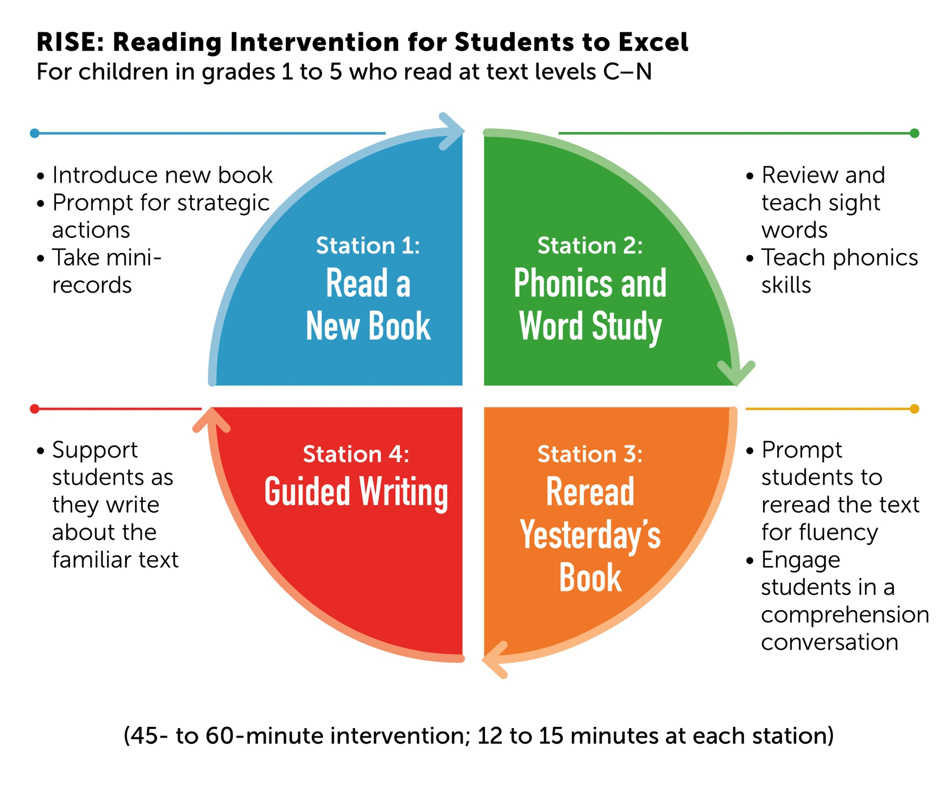
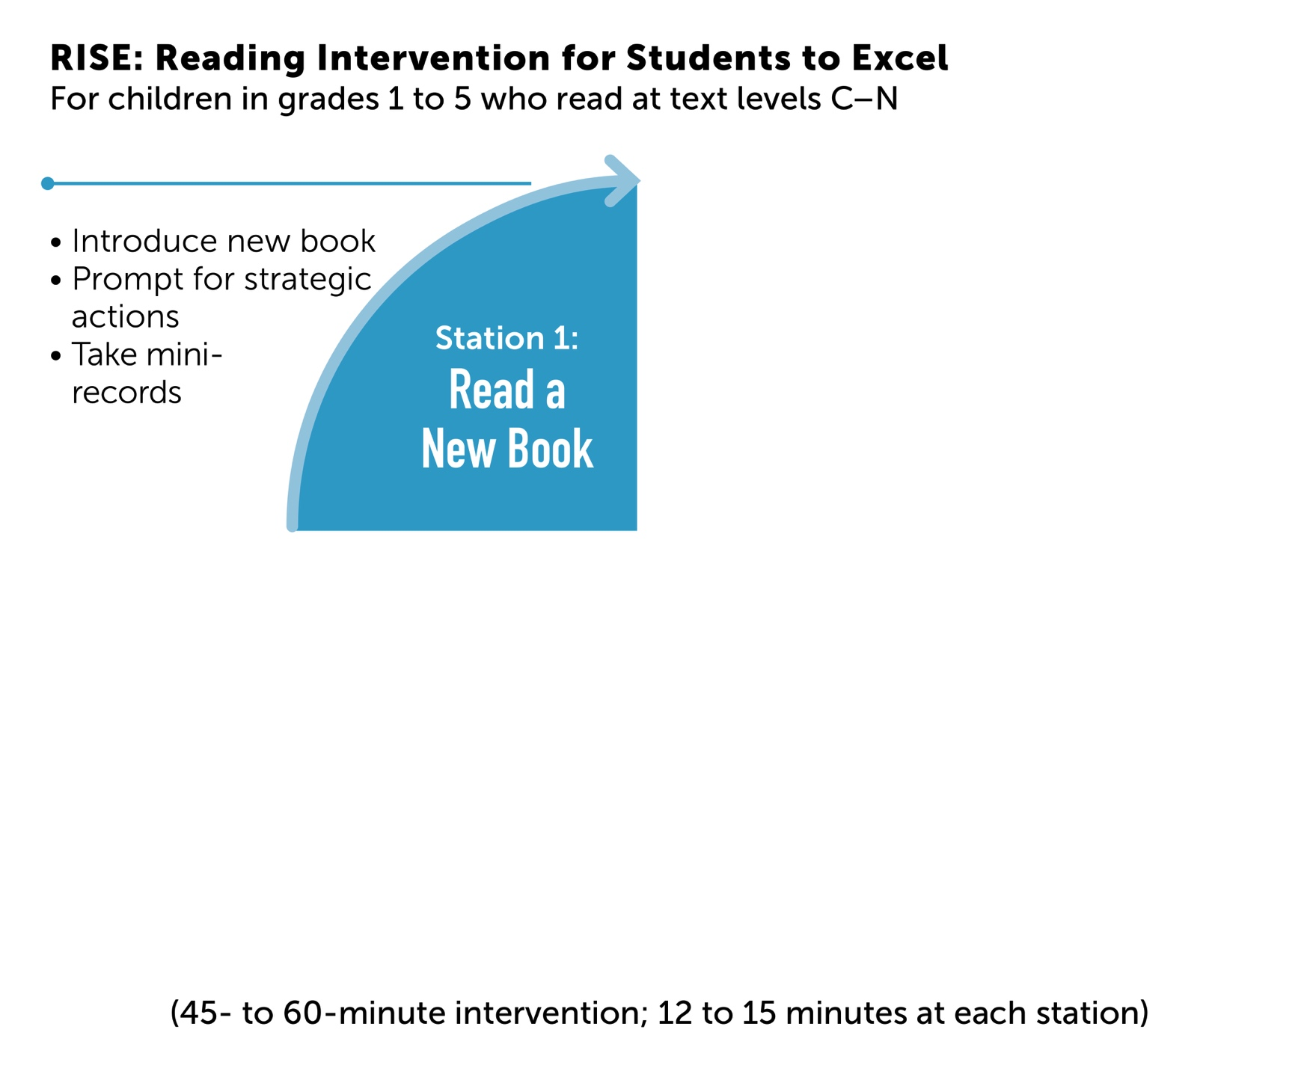
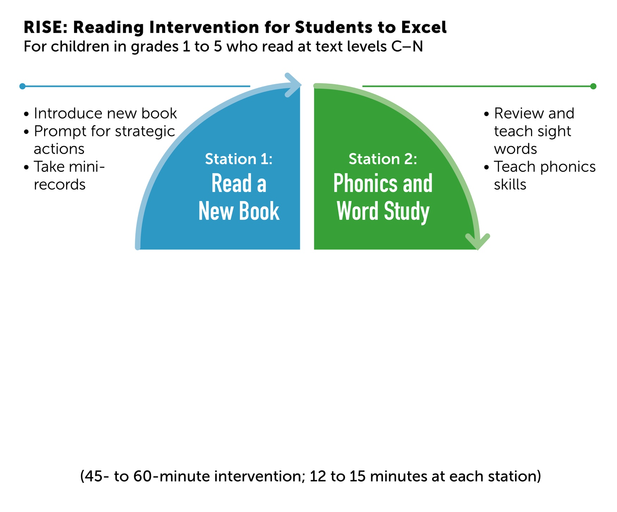
Notes:
In the 60-minute model, four small groups of students rotate through all four stations (12 to 15 minutes each). Instructors stay at one station and repeat the lesson to each group. All instructors will receive in-depth training in their station, and eventually should become proficient in teaching all four stations. (If you use the 45-minute model, three small groups rotate through three stations (12 to 15 minutes each): Stations 1, 2, and 4. Station 3, Reread Yesterday’s Book, is completed in the classroom with a buddy or at home.)

Slide 4
What Is RISE Up? Reading Intervention for Students to Excel
An effective model for grades 3 to 8, based on Jan Richardson's theory and practice of teaching comprehension.
For up to 12 striving readers, in 3 small groups.
Three stations that focus on literal comprehension, deeper comprehension, and guided writing; 45 minutes per day for 6 to 8 weeks.
Instruction that focuses on 12 strategies for literal and deeper comprehension.
Notes:
Most striving readers in the upper grades need support with comprehension. We are all familiar with students who can decode text but cannot comprehend beyond the literal level. RISE Up creates flexible and deeper thinkers by teaching students how to use various comprehension strategies on the same short text.
In Chapter 7 of NSFGR, Jan Richardson describes 29 modules for teaching 12 major comprehension strategies. Because RISE Up lessons target those 12 strategies, instructors need to be trained in how to teach each one.
Students are reading at about the same text level. They are divided into three groups (no more than four per group).
Students rotate through three stations each day, spending 12 to 15 minutes reading and discussing a short text. One station focuses on literal comprehension and the others target deeper comprehension and writing.
The 12 comprehension strategies can be found on page 256 in NSFGR and on page 85 in NSFRI.

Slide 5
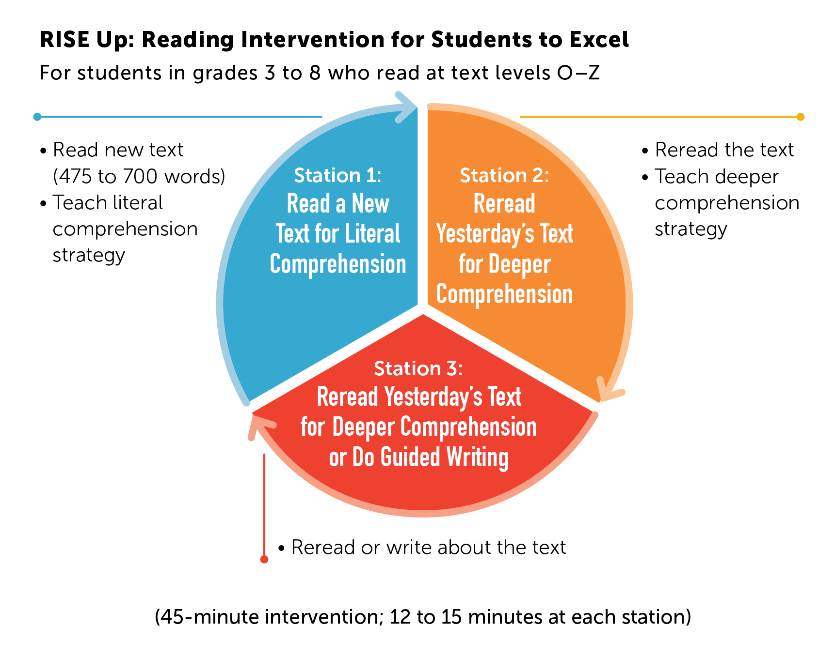
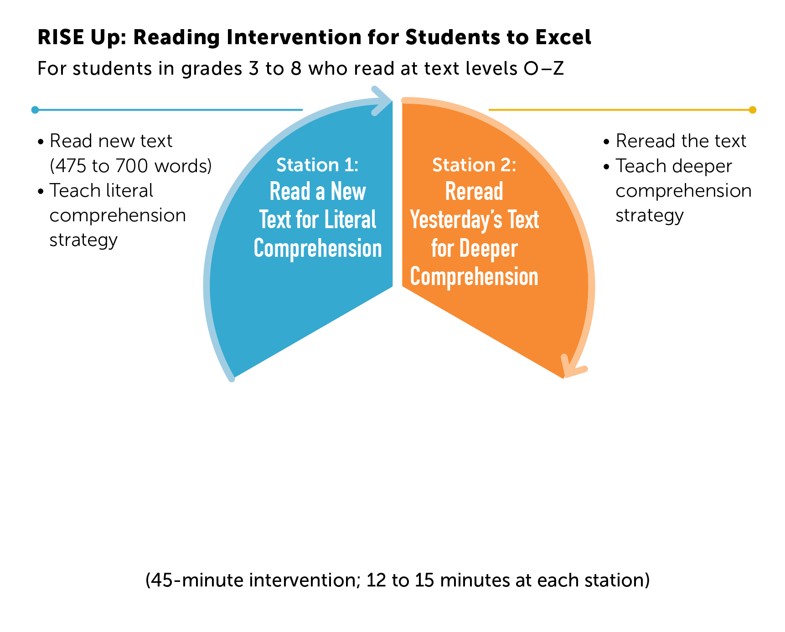
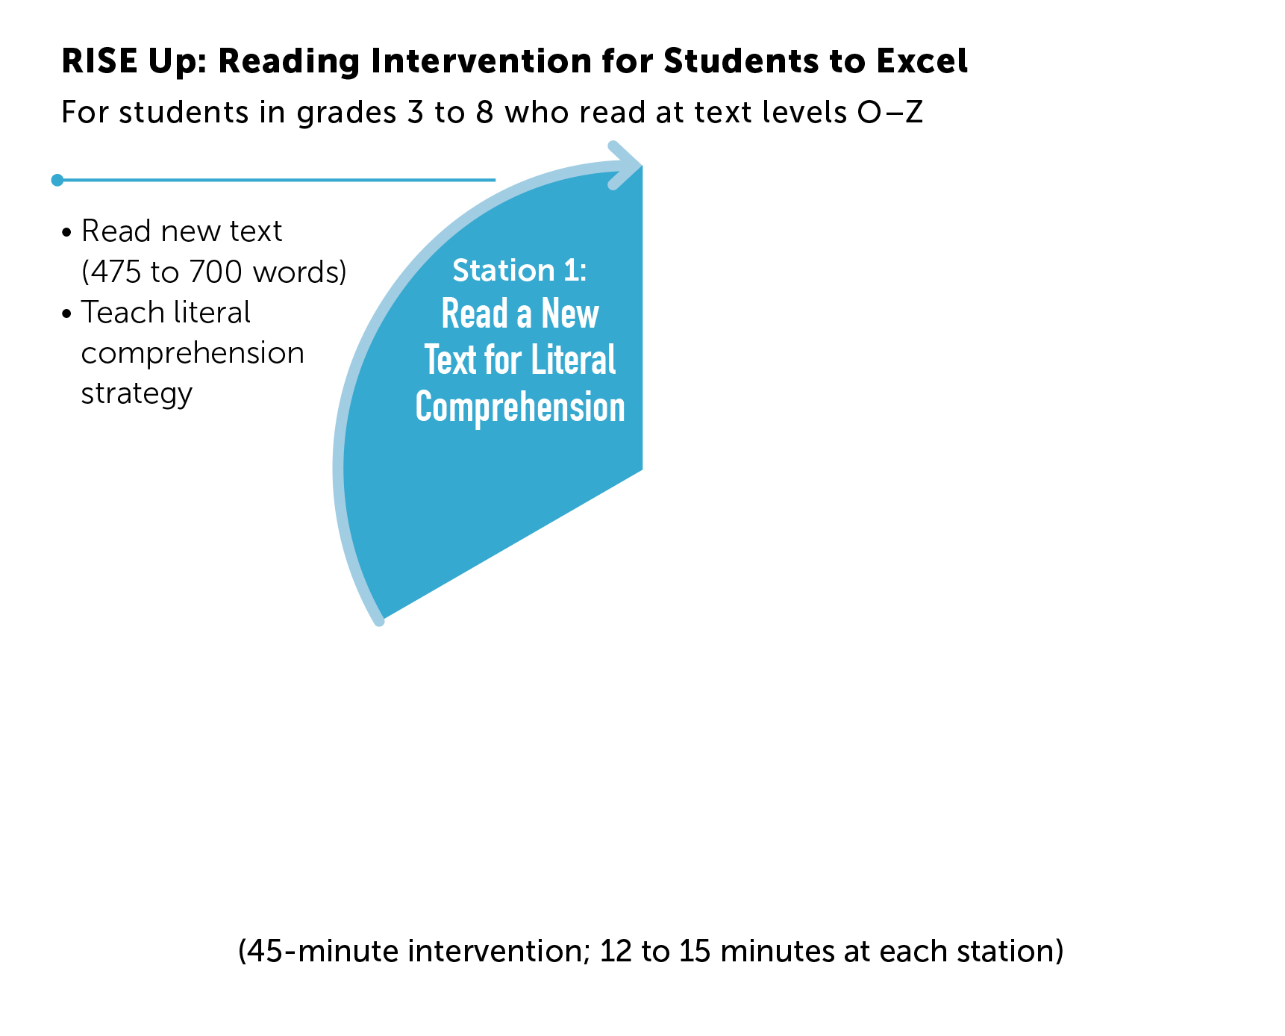
Notes:
For Station 1, the RISE Up instructor chooses a literal strategy and supporting module that best matches the chosen short text and the comprehension needs of the students. The literal strategies are listed on page 85 of NSFRI and described in modules 1 to 9 on pages 258–266 of NSFGR.
In Station 2, students reread the text they read in Station 1 on the previous day. This RISE Up instructor chooses a strategy that teaches deeper comprehension (strategies 5 to 12 on page 85 of NSFRI, modules 10 to 29 on pages 267–286 in NSFGR).
In Station 3, students either reread yesterday’s text (the same one they read in Station 2) but this time using a different comprehension strategy or they write about the text. Choose the guided writing option if students need writing support.
Note: There is an adaption of the RISE Up framework for classroom teachers. See Chapter 6 in NSFRI for more information if you want to implement this design. It is not included in this PowerPoint.

Slide 6

Teachers as Readers: Book Study
Notes:
Study both of these books with the team. It is imperative that all instructors are familiar with NSFRI and NSFRI. NSFRI is a handbook of how to implement RISE and RISE Up. However, the in-depth knowledge of Jan’s theory and practice that support RISE and RISE Up implementation is gained by reading NSFGR. The RISE lead teacher should lead the book study.

Slide 7
Implementing RISE and RISE Up
Meet with administrators, grade-level teams, and RISE and RISE Up instructors. Commit to 45 to 60 minutes a day, five days a week, for six to eight weeks.
Find a space with four tables for RISE and three tables for RISE Up. Gather materials.
Assess students using a formal leveled reading assessment and anecdotal notes.
Decide on students for RISE and RISE Up, with input from the grade-level teams. Decide on texts.
Guide students with daily lessons. Target specific skills based on daily observations.
Notes:
Implementing RISE and RISE Up requires following these steps, and we are in the process of working through them. (Be thinking about any information specific to your school such as access to leveled books and short texts, word study materials, location for teaching RISE and RISE Up, how you will select students, and when and how you will train instructors.)

Slide 8
Implementing RISE and RISE Up
at (your school name)
(materials, location, team meeting discussions to choose students)
(dates of training instructors, including NSFGR and NSFRI book study sessions)
(implementation dates)
Notes:
Create this slide to describe in detail how you will implement RISE and RISE Up at your school. Outline your proposed implementation on this slide. Be sure to include:
materials, location, team meeting discussions to choose students for RISE and RISE Up.
dates of training instructors, including NSFGR and NSFRI book study sessions.
implementation dates.

Slide 9
Our success with
RISE and RISE Up…
will depend on the fidelity of implementation. Follow The Next Step Forward in Reading Intervention framework and immerse yourself in the theory and practice of The Next Step Forward in Guided Reading.
Notes:
Success will depend upon training instructors, applying Jan’s theory, following the procedures in NSFRI with fidelity, and carrying out lessons as described in the book.
“We are excited to implement RISE and RISE Up at _________________. I’ll begin training instructors so we can start the program on ______. RISE and RISE Up will help our striving readers to become successful problem solvers and independent literacy learners.”

