Slide 1
RISE With Literacy
YOUR SCHOOL’S NAME
Families Read!
Notes:
Type your school’s name at the top.

Slide 2
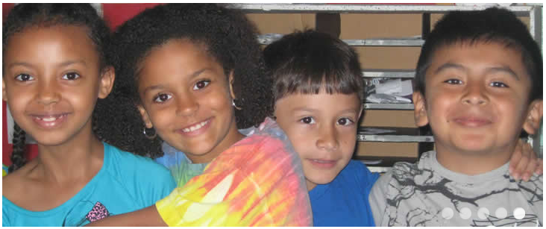
What research tells us about reading at home
You are your child’s first reading teacher.
You can make a difference in his or her reading life.

Slide 3

According to Scholastic’s Kids & Family Reading Report:
86% of kids ages six to 17 agree that reading is important and enjoy it.
87% of kids ages six to 11 enjoy read-aloud time with their parents.
72% enjoy it because it’s a special time together.
66% enjoy it because it’s fun.

Slide 4
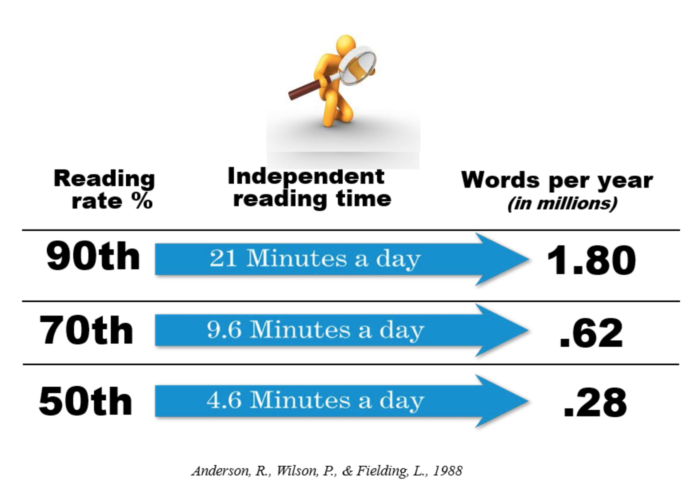
What research tells us about independent reading

Slide 5
Tips for reading at home
Read with or to your child every day.
Encourage your child to read independently as well, in a quiet place.
Make sure your child goes to bed at a regular time—early.
Make sure your child is reading easy or familiar books.

Slide 6
When you read with your child…
Sit side by side with the book visible to both of you.
If your child comes to a tricky word…
Pause
Prompt (Think about the story. Check the picture. Sound the first letters.)
Praise
Talk about the book when you’re finished.

Slide 7
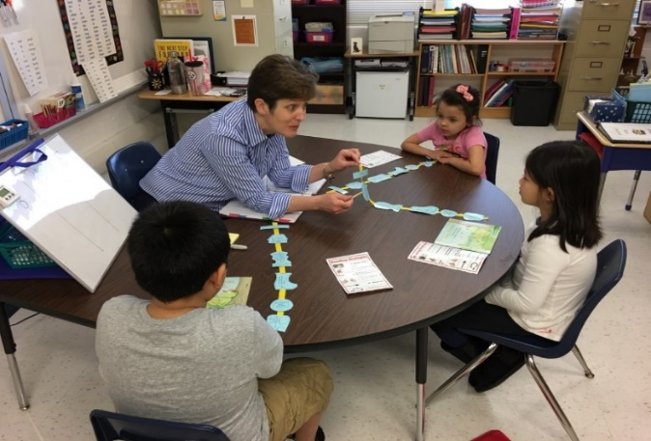
Tonight in Kindergarten
You will watch a teacher do the Story Retelling Rope procedure.
You will do the Story Retelling Rope procedure with your child.
Notes:
Replace “Story Retelling Rope” if you’ve chosen a different procedure.
Go to http://www.scholastic.com/NSFIntervention/ to find the Story Retelling Rope figures for Station 2 demonstration and practice.

Slide 8
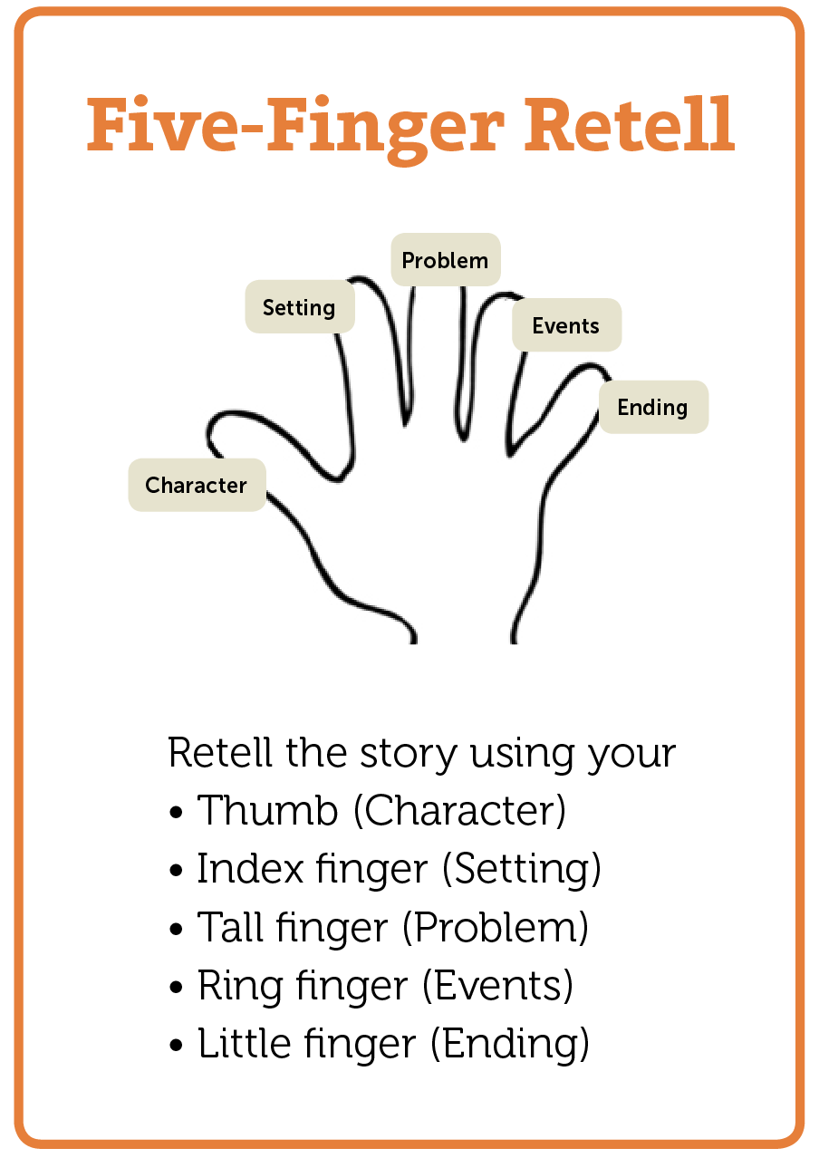
Tonight in First Grade
You will watch a teacher do the Five-Finger Retell procedure.
You will do the Five-Finger Retell procedure with your child.
Take-Home Card
Notes:
Replace “Five-Finger Retelling” if you’ve chosen a different procedure.
Go to http://www.scholastic.com/NSFIntervention/ to find the Take-Home Card shown here, as well as the Five-Finger Retell card for Station 2 demonstration and practice.

Slide 9

Tonight in Second Grade
You will watch a teacher do the Somebody-Wanted-But-So (SWBS) procedure.
You will do the SWBS procedure with your child.
Take-Home Card
Notes:
Replace “Somebody-Wanted-But-So (SWBS)” if you’ve chosen a different procedure.
Go to http://www.scholastic.com/NSFIntervention/ to find the Take-Home Card shown here, as well as SWBS card for Station 2 demonstration and practice.

Slide 10
It’s time to go to your next station!
Kindergarten to Room ___
First Grade to Room ___
Second Grade to Room ___
Then return for refreshments and a free book!
Notes:
Type room numbers for the stations.

